Slide 1
NSTIC’s Effects on Privacy The Need to Balance Identity and Privacy-Protection with Market Forces in the National Strategy for Trusted Identities in Cyberspace Supplement Presented by Aaron Titus, Esq. Chief Privacy Officer

Slide 2
Introduction
The National Strategy for Trusted Identities in Cyberspace (NSTIC) is a government-coordinated initiative to create a national private-sector digital identity system.
If implemented properly, NSTIC could improve privacy. As an aspirational document, NSTIC makes privacy a core principle but does not recommend regulation to ensure privacy. Without a regulation to implement NSTIC, powerful identity credentials will, if lost or stolen, enable hyper-identity theft. Market forces will likely 1) create a false sense of control, privacy, and security among users; 2) enable new ways to covertly collect users’ personal information; and 3) create new markets in which to commoditize human identity.

Slide 3
Findings
If implemented within a proper regulatory framework, an ideal NSTIC Identity Ecosystem could establish:
High levels of identity assurance online, increasing trust between Users and service providers.
More secure online transactions.
Innovation and new services.
Improved privacy and anonymity.
Increased convenience for Users and savings for service providers.

Slide 4
Findings
To successfully implement its visions of privacy, security, and secure identities, the NSTIC implementation must call for Federal regulation which will:
Hold all Identity Ecosystem Participants to legal and technical standards which implement Fair Information Practice Principles (FIPPs) and baseline privacy and security protocols.
Create incentives for businesses to not commoditize human identity.

Slide 5
Findings
Compensate for an individual’s unequal bargaining power when establishing privacy and data usage policies.
Subject Identity Providers to similar requirements to the Fair Credit Reporting Act.
Train individuals on how to properly safeguard their Identity Medium to avoid identity theft.
Ensure that consumers and advocates have a meaningful voice in the development of NSTIC policy.

Slide 6
Findings
Without regulatory policy, procedural safeguards and mandatory technology standards, NSTIC will fall short of its aspirations and may do more harm than good, creating the following results:
New ways to covertly collect personal information, and new markets to commoditize Users’ identities.
New, powerful credentials that will subject individuals to new risks of identity theft.
Identity Ecosystem Participants may not need to comply with industry baseline security or privacy protocols.

Slide 7
Findings
An enhanced Identity “Marketplace” which enables Participants to profit from the sale of human identities.
The Identity Ecosystem “Marketplace” would continue to be opaque to users, and may create a false sense of control, privacy, and security among Users
A User who opts out of the Ecosystem may also inadvertently lose privacy protections.
New, powerful NSTIC identity credentials will enable the same functionality as an Internet “Power of Attorney,” without the procedural safeguards offline Powers of Attorney provide.

Slide 8
Untrusted Identies
Self- Assertion
of Identity
Uncertainty,
Distrust,
Cost
User
Service
Provider
Notes:
As explained by Kaliya Hamlin, there are five fundamental types of identity verification:
Anonymity: The complete non-knowledge of an actor’s identity.
Pseudonymity: When an actor uses pseudonym in place of his/her real name.
Self-Asserted Identity: When an actor asserts his/her identity, without third-party verification.
Verified Identity: When a third party confirms an actor’s identity.
Verified Anonymity: When a third party verifies one or more attributes about an actor, without actual knowledge of the actor’s identity. Verified Anonymity relies upon complex technology, encryption and algorithyms.
The easiest forms of identity verification are anonymous, pseudonymous, and self-asserted identification. While these levels of identity verification may be sufficient for blogging and web surfing, they may be insufficient when interacting with banks, healthcare providers, or buying a house. However, without a reliable method to verify identities, service providers incur uncertainty and cost. To complicate matters further, credentials such as usernames and passwords can be lost, stolen, or forgotten.

Slide 9
Establishing a Trusted Identity
Trusted
Third Party
Verification of
Identity
Self- Assertion
of Identity
Certainty,
Trust,
Savings
User
Service
Provider
Notes:
Introducing a trusted third party in online transactions could have the following benefits to establishing verified identities online:
High levels of identity assurance online, thus increasing trust between Users and service providers
More secure online transactions
Innovation and new services
Improved Privacy
Increased efficiency and convenience for Users and service providers

Slide 10
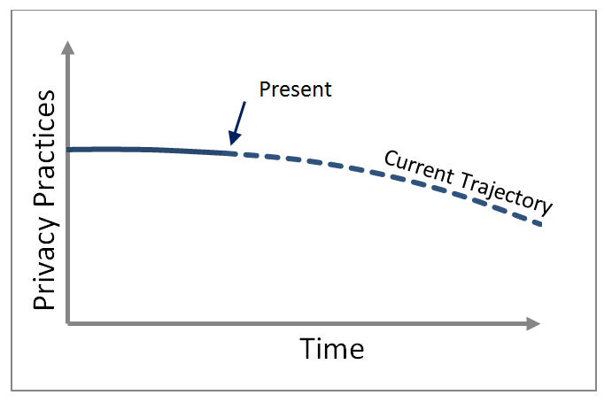
Privacy Practices Over Time
Notes:
Aaron Titus, an author of this report, raised several concerns about NSTIC’s effect on privacy with NIST officials. Those concerns included a lack of due process against government searches; unregulated Identity Providers; no mandatory adherence to Fair Information Practice Principles (FIPPs), and others. One NIST official thoughtfully listened to and responded to each concern. In addition to some very thoughtful responses, the NIST official counter-argued that each problem was already occurring in the present system, independent of NSTIC. He re-framed the discussion by suggesting that NSTIC, even in its worst possible implementation will be no worse than the status quo trajectory of privacy in the United States. He argued that with no down-side to privacy and only potential benefits, NSTIC should be adopted. In other words, NSTIC will have a net zero or positive effect on privacy.
This is an intriguing argument. Let’s assume, for argument’s sake, that privacy practices in the United States are following a trajectory which could be coarsely described by the graph.
The argument that NSTIC can do no more harm to privacy practices than our current path is hardly comforting, but is perhaps the single most logical and compelling argument in favor of implementing NSTIC. Any logical person would agree that one should adopt a system which can do no harm to privacy, while creating significant economic benefits.

Slide 11
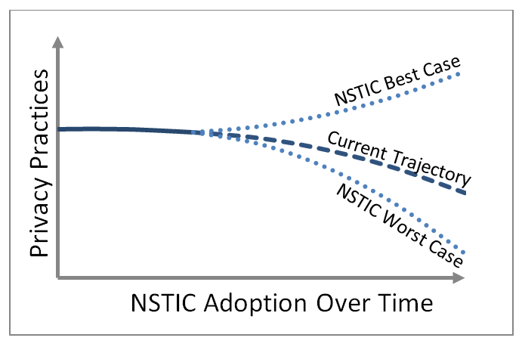
Possible NSTIC Effects on Privacy
Notes:
Thus, it is prudent to investigate the NIST official’s claim that NSTIC can create no more harm to privacy than will already occur in the inevitable future. This report concludes that despite NSTIC’s vision of privacy, success is far from assured. NSTIC will create new tools which will permit Ecosystem Participants to enhance or erode privacy. The tools, without the proper rules, to paraphrase Scott David, will be abused. As NSTIC does not currently propose legislation or regulation, it is far from certain that sufficiently privacy-enhancing rules will be developed or that they will have the force and effect of law. This means that NSTIC’s worst (or even realistic) case could theoretically be worse than the status quo, as illustrated here

Slide 12
Identity Ecosystem Core Concepts
Attribute
Providers
Identity
Provider (IdP)
Third Party
User
Relying
Party (RP)
Parent
Company
Data Usage
Policy
Transaction
Information
Notes:
(NPE) which must assert its identity to a Relying Party in order to receive a benefit such as access to a trusted network, bank account access, or access to premium content online.
An Attribute Provider (AP) creates, stores and allows others (such as the Identity Provider and Relying Party) to access or analyze User Attributes, usually under conditions. An Attribute Provider is also usually a Third Party. In the Identity Ecosystem, an Attribute Provider must be trusted as an authoritative source of information. Typical examples of attribute providers might be a government title registry, national credit bureau, or commercial marketing database.
An Attribute is a fact related to a User. Attributes may include traditional PII, information about authority, roles, rights, privileges, or any other fact asserted by a User, Attribute Provider, or Third Party.
An Identity Provider (IdP) is an organization certified as trustworthy through an accreditation authority. An IdP issues a credential, which corresponds to a piece of information known to the User (such as a password), a biometric attribute, or information stored on an Identity Medium (not represented herein). An IdP is responsible for verifying the credential when used as evidence of a User’s identity. An IdP may collect attributes about the User from Attribute Providers, store those attributes, and compare them against assertions made by the User to a Relying Party. Identity Providers do not guarantee the correctness of attributes obtained from Attribute Providers, but may instead confirm that a Claim made by a User matches information from Attribute Providers. Identity Providers may share User attributes, personal information, and Transaction Information with Relying Parties, Third Parties, Parent Companies and Attribute Providers, in accordance with the Data Usage Policy.
A Data Usage Policy is a contract between a User and Identity Provider, governing the use and disclosure of User information held by the Identity Provider.
Transaction Information is a record of the benefit provided to the User from the Relying Party, and is analogous to a receipt. Transaction Information may include the name of a product purchased, a log of network access and User activity, or services provided.
Identity Medium refers to the physical device that stores an NSTIC-compatible identity credential. Examples of Identity Mediums include cell phone apps, smart cards, or computer dongles. Identity Media are not visually represented in this report, and are not required for a transaction.
A Relying Party (RP) is a person or NPE that requires some degree of identity assurance and possibly User Attributes before it will provide a benefit to the User.
A Parent Company is a company which owns or is affiliated with the Identity Provider and/or the Relying Party in such a way that by action of law, ownership or contract, the Parent Company has right to access and use the Identity Provider or Relying Party’s data assets, unless expressly prohibited by law or regulation.
A Third Party is any person, organization, system, or device which has no direct affiliation with the User or the transaction in question. A familiar example of a Third Party is an online advertiser.
For purposes of this report, we define a Claim as an assertion that an Attribute is truthful or correct. A Claim may be made by any party. Examples of User Claims are, “I am over 18 years old,” “I am a constituent or citizen,” or “I am authorized to enter your network.” Claims are not visually represented in this report. In technical circles, a “claim” is an assertion that may be derived by comparing or analyzing one or more Attributes.
According to NSTIC, the Identity Ecosystem Framework is “the overarching set of interoperability standards, risk models, privacy and liability policies, requirements, and accountability mechanisms that structure the Identity Ecosystem.”
The Identity Ecosystem Marketplace is the Identity Marketplace created by the Identity Ecosystem, where Identity Ecosystem Participants may commoditize and trade User identities and Attributes in exchange for benefits. Not all Identity Ecosystem transactions necessarily commoditize human identity. The exchange of identity information in many e-commerce transactions is ancillary to the transaction, and the User pays directly for the benefit of the transaction (e.g. a money transfer, music or movie download). Notwithstanding, the Identity Ecosystem Marketplace enables Participants to more easily commoditize identity as an additional source of revenue.
Fair Information Practice Principles (FIPPs) are Transparency, Individual Participation, Purpose Specification, Data Minimization, Use Limitation, Data Quality and Integrity, Security, and Accountability and Auditing. NSTIC identifies FIPPs as core requirements in the Identity Ecosystem, but stops short of mandating FIPPs. National Strategy for Trusted Identities in Cyberspace: Enhancing Online Choice, Efficiency, Security, and Privacy, April 15, 2011, p. 24. http://www.nist.gov/nstic.

Slide 13
Current Typical Transaction
Attribute
Providers
Identity
Provider (IdP)
Third Party
User
Relying
Party (RP)
Parent
Company
Communication Diagram
Notes:
Verified transactions occur between consumers and service providers even today. A simplified verified transaction today is illustrated here. In this example, the Relying Party could be an online service provider, while the Attribute Provider could be a Credit Reporting Agency. In Figure 6, the numbers and lines represent the following communications among Participants:
1. The User requests a service or benefit from the Relying Party
2. The Relying Party requests personal information, such as a SSN and other Personally Identifiable Information (PII)
3. The User provides his SSN and PII to the Relying Party
4. The Relying Party sends the SSN and PII to an Attribute Provider
5. The Attribute Provider rarely has a duty to ask the User permission to share additional PII with the Relying Party or Third Parties.
6. The Attribute Provider verifies that the SSN and PII match its records, and may send additional information, such as a credit score to the Relying Party.
7. The Relying Party provides the benefit, and absent fiduciary or contractual limitations, may share the SSN and PII with its Parent Company and Third Parties.

Slide 14
Current Typical Transaction
Attribute
Providers
Identity
Provider (IdP)
Third Party
User
Relying
Party (RP)
Parent
Company
Attributes from
Attribute Providers
Money or
Other Value
Attributes from User
Transaction
Information
Notes:
Figure 7: Current Typical Verified Identity Transaction (Identity Market Diagram)
In Figure 7, data and money (or other value) is typically exchanged in the following manner during a verified identity transaction:
1. The User provides the Relying Party PII or other personal Attributes, as well as money or value in exchange for a benefit.
2. Attribute Providers give the Relying Party additional User Attributes, in exchange for money or value.
3. Absent fiduciary or contractual limitations, the Relying Party may aggregate and share the User Attributes and Transaction Information with third parties, in exchange for money or value.
4. The Relying Party is often required to share Transaction and aggregated User Attributes with its Parent Company.

Slide 15
Ideal Federated Identity Trans.
Attribute
Providers
Identity
Provider (IdP)
Third Party
User
Relying
Party (RP)
Parent
Company
Notes:
Figure 8: Ideal Federated Identity Transaction (Simplified Communication Diagram)
Figure 8 outlines an ideal verified federated identity transaction that utilizes privacy-enhancing technology, zero-knowledge proofs, and implements generally accepted FIPPs, including data minimization. In this simplified communications diagram, an ideal Federated Identity Transaction would include the following steps:
1. The User contacts the Identity Provider, and dictates the terms of the Data Usage Policy to the IdP, which the IdP accepts. The User then provides PII to the Identity Provider.
2. The IdP may contact Attribute Providers, requesting that the Attribute Provider confirm the User’s Attributes, and perhaps share additional Attributes.
3. Ideally, an Attribute Provider will a duty to ask the User’s permission to share or confirm attributes. However, this will not always be the case. For example, while a healthcare clearinghouse may be required to get consent to share Attributes, an online marketing agency may not.
4. However, in the rare event that an Attribute Provider must ask consent, the User would provide it.
5. The Attribute Provider verifies the User’s PII to the IdP.
6. Later, the User requests a service from a Relying Party. The Relying Party must know certain Attributes about the User before it can provide a benefit. Instead of giving the Relying Party his date of birth, the User asserts that he is over 18 years old.
7. Ideally, the User does not share his NSTIC credential with the Relying Party, but transmits it directly to the IdP, with no information about the transaction.
8. The IdP transmits a message to the Relying Party, verifying the User’s identity.
9. In a zero-knowledge transaction, the IdP would have no knowledge of the details of the transaction.
This implementation of NSTIC creates a better privacy outcome than the current trajectory of privacy practices in the United States.

Slide 16
Ideal Federated Identity Trans.
Attribute
Providers
Identity
Provider (IdP)
Third Party
User
Relying
Party (RP)
Parent
Company
Attributes from
Attribute Providers
Money or
Other Value
Verification of
User’s Identity
Attributes from User
Or Claim
Data Usage Policy
Transaction
Information
Notes:
Figure 9: Ideal Federated Identity Transaction (Identity Market Diagram)
Figure 9 analyzes the same transaction as Figure 8, in terms of the exchange of data and money among the Identity Ecosystem Market participants. In this Identity Ecosystem Market diagram of an Ideal Federated Identity Transaction, the exchange of data and money would proceed as follows:
1. The User gives the Identity Provider a limited amount of personal information, and money or other value for the IdP’s service, then dictates the terms of the Data Usage Policy, which the IdP accepts.
2. Attribute Providers may provide additional attributes to the IdP in exchange for money or value.
3. The User gives the Relying Party a limited amount of personal information in the form of a Claim. The User may also pay the Relying Party money for the benefit.
4. Instead of providing personal information to the Relying Party, the Identity Provider certifies that the User’s Claim is true.
5. The Identity Provider may have limited or no knowledge about the transaction between the User and Relying Party, depending upon the technology used.
This implementation of NSTIC creates a better privacy outcome than the current trajectory of privacy practices in the United States.

Slide 17
Likely Federated Identity Trans.
Attribute
Providers
Identity
Provider (IdP)
Third Party
User
Relying
Party (RP)
Parent
Company
Attributes from
Attribute Providers
Money or
Other Value
Verification of
User’s Identity
Attributes from User
Or Claim
Data Usage Policy
Transaction
Information
Notes:
Figure 10: Realistic NSTIC Data Transaction (Identity Market Diagram)
Even though the following scenario sharply conflicts with the aspirations of NSTIC, without proper policy restrictions, a likely Identity Ecosystem Marketplace transaction would proceed much like a transaction today, but with more opportunities to buy and sell data:
1. As a condition of service, the IdP dictates the Data Usage Policy to the User, which the Identity Provider to maximize the economic value of the User’s personal information.
2. In exchange for services, the User accepts the Data Usage Policy and provides the IdP with money or other value for the IdP’s service, along with personal information
3. Attribute Providers may provide additional Attributes to the IdP in exchange for money or value.
4. In exchange for a benefit, the User gives the Relying Party a limited amount of personal information in the form of a Claim. The User may also pay the Relying Party for the benefit.
5. In order to maintain a needed source of income, the Relying Party may purchase additional User Attributes from Attribute Providers, which it may then enrich with Transaction Information and sell to Third Parties (see #10). Relying Parties may purchase additional information from Attribute Providers, even in an ideal implementation of an NSTIC Federated Identity System. Relying Parties may use this information for financial gain, or sharing may be practically necessary for highly variable Attributes which cannot be reliably stored with the IdP (e.g., GPS location data).
6. The Relying Party requests the IdP to confirm the User’s Identity, and the IdP verifies the identity and provides additional User personal information to the Relying Party as permitted by the Data Usage Policy. This transaction might be facilitated by trading Transaction Information for User Attributes (see #7), or the Relying Party and Identity Provider may be owned by the same Parent Company (see #9 and #11); or the Relying Party and IdP may have some other affiliate agreement.
7. The Relying Party shares Transaction Information with the IdP, and may share money or other value.
8. In accordance with the Data Usage Policy, the IdP can enrich the User Attributes with Transaction Information which it may sell to Third Parties.
9. The IdP shares all User Attributes and Transaction Information with its Parent Companies and Affiliates.
10. The Relying Party may share all User Attributes and Transaction Information with Third Parties.
11. The Relying Party shares all User Attributes and Transaction Information with its Parent Companies and affiliates.
Because Identity information is traded more widely, this implementation of NSTIC creates a worse privacy outcome than the status quo represented by Figures 6 and 7.

Slide 18
Technology Enables Markets, Policy
Technology
Enabled Market,
Enabled Policy
Insufficient
Technology
Disabled Market,
Disabled Policy
Notes:
three great forces will shape the future of identity and privacy: Market forces, Policy forces, and Technology. For purposes of this report, “Market” forces are defined broadly and include all social, economic, behavioral and other forces which drive the actions of individuals and organizations. “Policy” is similarly broad, and includes formal law, regulation, and government intervention generally.
We will analogize Market and Policy forces to two train engines, and analogize technology to the train track on which the engines run. While the engines may pull together or apart from one another, the technology enables and places limits on these two great forces as they awkwardly interact, as illustrated in Figure 11.
Technology Enables Policy and Markets to Achieve Goals
In this analogy, technology is no passive participant. After all, the engines of Market and Policy are bound to the paths technology chooses to take it. Without the enabling technology, Google’s business plan would have failed in 1950. Similarly, wiretap laws would have had no meaning without Alexander Graham Bell’s invention, the telephone.
Lawrence Lessig expressed a similar idea in his famous essay, The Code Is the Law.
“The single most significant change in the politics of cyberspace is the coming of age of this simple idea: The code is law. The architectures of cyberspace are as important as the law in defining and defeating the liberties of the Net. Activists concerned with defending liberty, privacy or access must watch the code coming from the [Silicon] Valley - call it West Coast Code - as much as the code coming from Congress - call it East Coast Code…. Let them [each] publish their regulations, so the regulated can choose.”
The Code Is the Law, April 9, 1999. http://www.lessig.org/content/standard/0,1902,4165,00.html (Accessed March 28, 2011).

Slide 19
Ideal Interactions
Enabling
Technology
Maximum
Benefit
Maximum Benefit
Notes:
Ideal Interactions Among Technology, Policy, and Market Forces
While Technology may enable and set bounds to Policy and Market forces, technology cannot mandate the direction these forces will go. A hammer cannot determine whether it is used for construction or demolition. Automobiles cannot avoid injuring a pedestrian in the hands of a negligent driver. A light bulb cannot turn itself on or off. Technology can no more create market forces, nor unilaterally solve policy problems than a track can force a train to travel forward or backward.
Ideally, technology, policy, and market forces will work together to reach a point of maximum benefit. Maximum benefit may not mean “no harm,” and of course, defining “maximum benefit” is an ongoing subject of debate among economists, philosophers, and politicians to name a few.
Notwithstanding the rhetorical difficulties posed by the term “maximum benefit,” Figure 12 illustrates two Ideal interactions among Technology, Policy, and Market forces. If the maximum benefit requires effort in a single direction, then the Market and Policy should work together in the same direction to reach the maximum benefit. In contrast, if the maximum benefit requires balancing two or more ideals, then Policy and Market forces should exert some degree of tension on one another to achieve the proper balance of interests.

Slide 20
Faulty Interaction
Maximum
Benefit
Notes:
The opposite of an ideal interaction among Technology, Policy, and Market forces is the instance where Policy and Market forces work together, counteractive to the maximum benefit, as illustrated in Figure 13.

Slide 21
Sharing/Hoarding Profit/Privacy
NSTIC Enabling Technology
Identity Sharing
(Secure or Insecure)
Identity
Hoarding
Profit
Privacy
Notes:
NSTIC Technology Enables Identity Sharing or Hoarding
NSTIC is a policy, not a technology. From an Identity Marketplace perspective, federated identity technology can be implemented to share or hoard identities and personal information. “Sharing” includes trading, selling, renting, licensing and giving; while “hoarding” simply means that the identity information is not traded, sold, rented, licensed or otherwise shared with another party.
Figure 14: Federated Identity Technologies Enable Data Sharing (Secure or Insecure), or Data Hoarding
The dichotomy between “share” and “hoard” should not be mistaken for “secure” and “insecure.” As technologists in this field know, both sharing and concealing may be done in secure or insecure manners. For the purposes of this report we will take a large leap of faith and assume that all identity information will be shared or stored using secure technological and business processes. Implementing security protocols in a business environment is a subject for a different report.
Identity Sharing is Profitable; Hoarding Improves Privacy
Since identities and personal information have value, trading and sharing identities generally yields profit while the very act of sharing decreases privacy. In contrast, while hoarding identity information improves privacy, it is not profitable in most circumstances.
Figure 15: NSTIC Enables Profit or Privacy
This thesis is supported by even a cursory look at current market conditions. Data and identity aggregation is a multi-billion dollar business and it is almost axiomatic to say that neither Google nor Facebook’s combined $200+ Billion market capitalization was amassed by keeping personal information private.
Federated Identity technology enables sharing or hoarding, or in other words, profit or privacy. All business models have one thing in common: They favor profit, as illustrated in Figure 16:
Figure 16: Market Forces Favor Profit
We note that some entrepreneurs have developed innovative and (unfortunately) niche business models which make privacy profitable. We applaud and encourage companies to develop business models that make money by improving privacy and do not depend upon the commoditization of human identity. We also note, however, that notwithstanding these pioneering business models, identity trading remains a multi-billion dollar industry, and a primary threat to individuals' privacy and security.
A User may consent to identity sharing. Consent to eliminate privacy does not improve privacy; consent simply authorizes decreased privacy.

Slide 22
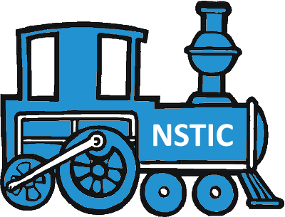
NSTIC Should Balance the Market
Profit
Privacy
Maximum
Benefit
Notes:
We believe that Privacy is worth protecting; and we understand that businesses must be profitable. Therefore, to obtain the maximum benefit NSTIC Policy and Market forces must balance the interests of profit and privacy. As illustrated in Figures 12b and 17, this means that NSTIC Policy should create some tension with Market forces.
NSTIC implementation policy must take concrete regulatory steps to balance profit and privacy.
Even though privacy-enhancing technology exists, without the proper policy, law, and regulatory safeguards in place from the outset, Market forces will reject or misuse these technologies. Profit-oriented businesses would be incentivized to use the NSTIC framework as a tool to obliterate privacy, anonymity and its attendant liberties, in all but the fewest of circumstances. NSTIC aspires to privacy, but does not yet have the force to make its aspirations a reality. In short:
The Market won’t protect privacy.
Technology can’t create Policy.
NSTIC Policy must protect privacy, but doesn’t (yet).
Unsolved NSTIC Policy Hurdles
If NSTIC is to accomplish its vision, future regulations must address a range of severe policy vulnerabilities which remain unsolved. These security risks do not entail circumventing technology, but rather are technology-independent. As a result, these problems cannot be solved through technology alone; policy problems must be solved through better policy.
Without regulatory mandates that require IdPs and Relying Parties to follow minimum standards for privacy-enhancing technologies or basic security, these Market Participants will have multiple incentives to behave in ways detrimental to Users’ Privacy. For reasons discussed in detail above, the Market is not likely to self-regulate best practices into their business processes.

Slide 23
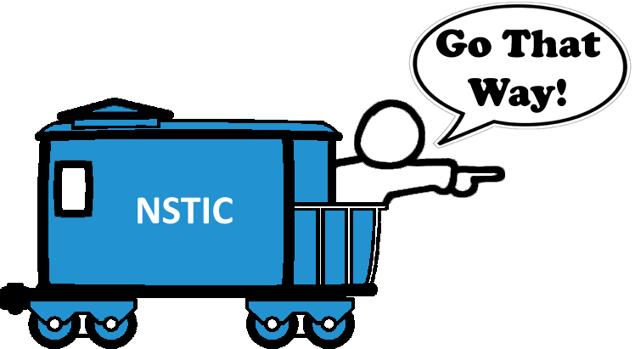
NSTIC Policy Lacks Force
Profit
Privacy
Notes:
NSTIC Policy Looks the Right Direction, but Lacks Force
Figure 18: NSTIC Envisions Privacy, but Does Not Yet Envision a Regulatory Framework to Make it Real.
NSTIC implementation policy must take concrete regulatory steps to balance profit and privacy.
Even though privacy-enhancing technology exists, without the proper policy, law, and regulatory safeguards in place from the outset, Market forces will reject or misuse these technologies. Profit-oriented businesses would be incentivized to use the NSTIC framework as a tool to obliterate privacy, anonymity and its attendant liberties, in all but the fewest of circumstances. NSTIC aspires to privacy, but does not yet have the force to make its aspirations a reality. In short:
The Market won’t protect privacy.
Technology can’t create Policy.
NSTIC Policy must protect privacy, but doesn’t (yet).
If NSTIC is to accomplish its vision, future regulations must address a range of severe policy vulnerabilities which remain unsolved. These security risks do not entail circumventing technology, but rather are technology-independent. As a result, these problems cannot be solved through technology alone; policy problems must be solved through better policy.
Without regulatory mandates that require IdPs and Relying Parties to follow minimum standards for privacy-enhancing technologies or basic security, these Market Participants will have multiple incentives to behave in ways detrimental to Users’ Privacy. For reasons discussed in detail above, the Market is not likely to self-regulate best practices into their business processes.

Slide 24
NSTIC Policy Vulnerabilities
FIPPs May not be a Silver Bullet
Data Usage Policies will Favor IdPs or Relying Parties, Not Users’ Privacy
Identity Providers will Create Centralized Databases of Personal and Transaction Information
Retail vs. Wholesale Privacy
Identity Providers’ Effect on Anonymity
Identity Provider Databases
Using Multiple IdPs to Achieve Data Fragmentation
IdPs as Identity Reporting Agencies

Slide 25
NSTIC Policy Vulnerabilities
Identity Providers Must Be Regulated
IdPs Not Required to be Identity Oracles
Accreditation’s Effect on IdP Behavior
User Rights will End Upon Data Policy Deletion

Slide 26
Ending the IdP Relationship
Attribute
Providers
Identity
Provider (IdP)
Third Party
User
Relying
Party (RP)
Parent
Company
Attributes from
Attribute Providers
Money or
Other Value
Transaction Information
Data Usage Policy
Notes:
Figure 19: User Ending Relationship with IdP (Identity Market Diagram)
Ending a contract with an Identity Provider may create the following challenges:
1. The User terminates the relationship and Data Usage Policy between himself and the Identity Provider.
2. Free from contractual obligations to the User, the Identity Provider may now sell personal information enriched with Transaction Information to Attribute Providers…
3. …and Third Parties.
4. The Identity Provider may still share User information with Parent Companies.
5. Parent Companies may share it with other child companies.

Slide 27
NSTIC Policy Vulnerabilities
Identity Credentials will be Analogous to an Internet “Power of Attorney” Without Procedural Safeguards
NSTIC Credentials will Create New Identity Theft Vectors
Unregulated Relying Parties May Use NSTIC IDs to Over-Identify Users
NSTIC Must Provide Recourse to Correct False Information or Damage to Reputation
NSTIC May be Similar to, but is Not a “National ID”

Slide 28
NSTIC is Not a National ID
How NSTIC is Not Like a National ID | How NSTIC Might be Like a National ID
NSTIC credentials are not owned, issued, or managed by the Federal Government, except for IDs issued to government employees. | If adopted by a majority of state governments, NSTIC credentials could become standard in State IDs and drivers licenses. The Federal Government could also embed an NSTIC credential in passports.
Identity Provider Databases are not under government control, except for a few run by the Federal Government for government employees. | Identity and personal information which enters the Identity Ecosystem Marketplace is subject to very little protection against government search and seizure under the 4th Amendment.
NSTIC is voluntary for the private sector and private citizens. | If adopted by State governments, which control a substantial portion of the identification market, NSTIC credentials could become mandatory and displace private sector identity competitors.
NSTIC credentials are not yet required to access government benefits. | Access to electronic government services may one day require an NSTIC credential.

Slide 29
Copyright Notice
Identity Finder” and the Identity Finder logo are trademarks of Identity Finder, LLC.
This report, and all associated material (including images and accompanying presentations) are copyrighted by Identity Finder, LLC. Other than Identity Finder trademarks, all material herein is licensed under a Creative Commons Attribution 3.0 Unported License. Identity Finder trademarks are licensed for attribution purposes only.
The purpose of this report is to enrich the public discussion and encourage debate. The authors hope that academics, technologists, policy makers, the public, and the media will reuse, republish, and remix the contents of this report with attribution to Identity Finder and the Authors.

Slide 30
Identity Finder, LLC
www.identityfinder.com

